Slide 1
Field tests log_020 → log_022
Team B3
From a manual drive run to a teach-and-repeat route follower
Case Study Cooperative and Autonomous Systems · THD · 03.11.2026
Notes:
Three logs, three steps. log_009 gave us a clean reference route. log_010 tested the first autonomous mission and showed GPS cannot be the primary guide. log_011 tested the segment follower and revealed how the rover physically turns.

Slide 2
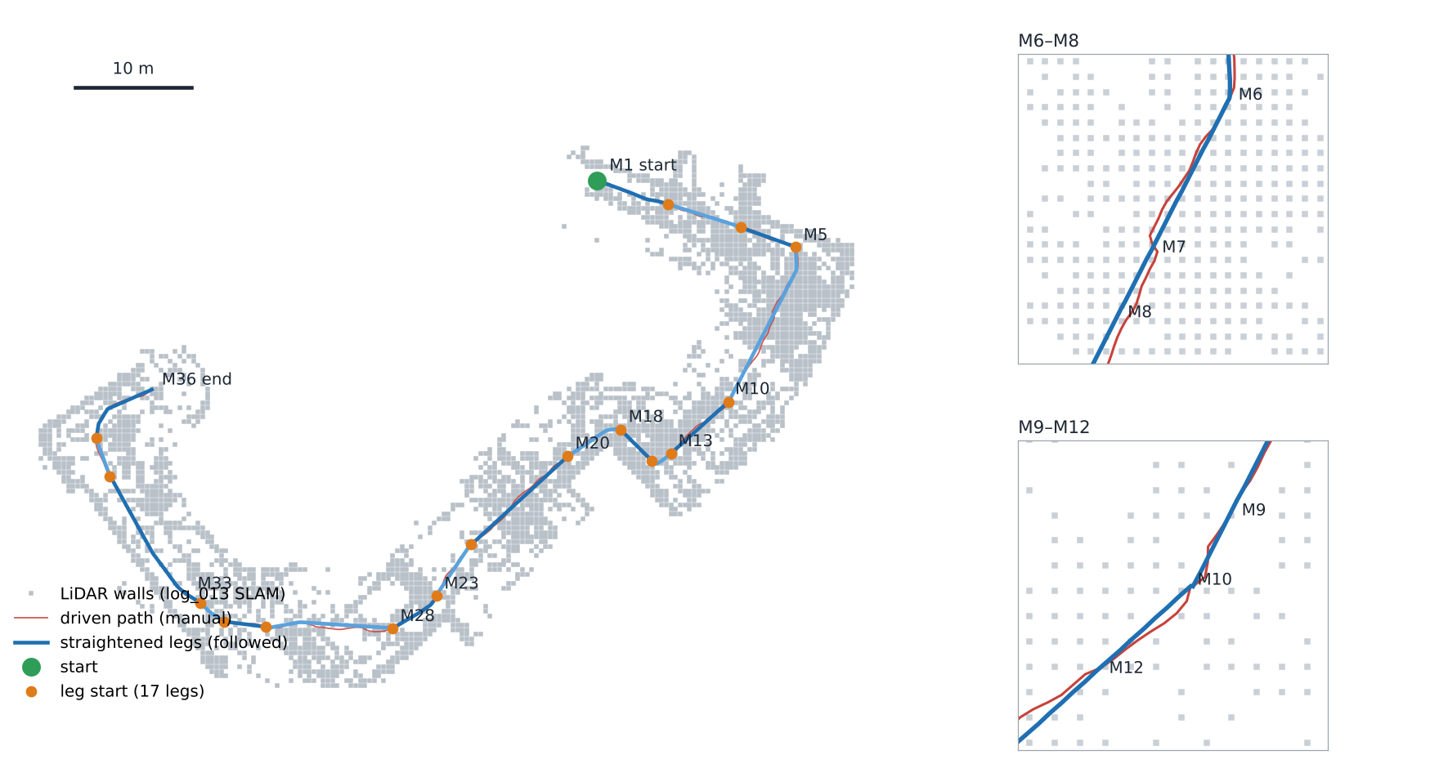
One map, 17 local legs, straight lines
LOG_013 · SLAM MAP AND TAUGHT PATH
Map
IMU + LiDAR scan matching of the manual drive log_013. No GPS.
17 legs
Cut at the Marks. Each leg has its own frame: origin = leg start, x = heading there.
Straightened
Within 0.45 m of the driven path, ≥ 25 cm from walls. Leg 9: 185° → 25° of turning.
log_013 map, tools/localpath.py + make_webmap.py Yugeshwar
Notes:
The map is built only from the IMU and the LiDAR of the manual teaching drive log_013 (tools/lidar_map.py), no GPS. The route is cut into 17 legs at the Marks. Every leg is stored in its own local frame (origin = where the leg starts, x = rover heading there), together with a 10 cm likelihood grid of the walls around it (LocalPath.h, about 290 kB of flash). Red is the path as I drove it by hand: full of small left corrections against the rover's ~5–6 deg/s right drift, plus back-ups at M7 and M10–M12. Blue is what the box follows now: Douglas–Peucker straight pieces, at most 0.45 m away from the driven path, and only accepted if they keep at least 25 cm (or the clearance my drive had) to the mapped walls. Example: leg 9 has 185 deg of heading changes when driven, 25 deg straightened. The rover can only drive straight and turn on the spot, so straight pieces with few corners are the path it can follow best.

Slide 3

Control loop: localise, steer, protect
LATEST APPROACH · CONTROL ALGORITHM
LocalLocalizer
Path follower
Tap control
SafetyGuard
MotorShaper
WAVE ROVER
pose in leg frame
Pure pursuit 1 m ahead
timed turn + wait
obstacle, tilt
smooth wheels
Wi-Fi, ~100 ms
Localise · every 0.25 s
Steer · 50 Hz gyro
Every command
Predict: gyro Δyaw; distance = 1.0 m/s × command × dt
Correct: 90-point scan vs leg grid, ±0.4 m / ±4°, then 2 cm / 1°
Heading change against the gyro costs score
Lost (8 scans or > 1 m off): search ±3 m along the path
Localise Kamal
Notes:
No GPS anywhere in the loop. Localise: every LiDAR snapshot (4 Hz) the box predicts its pose in the current leg frame from the gyro and the forward command (1.0 m/s per unit command, battery-equivalent), then matches the 90-point scan against the leg's 10 cm wall grid: coarse ±0.4 m / ±4°, fine 2 cm / 1°. Since log_023 a heading change against the gyro costs match score (thPrior 40 per rad², 4° = 0.2), because weak matches had turned the heading 30° away from the gyro. When lost (8 scans without a match, or more than 1 m off the path) it searches ±3 m along the taught path. At the end of a leg the pose is handed into the next leg's frame. Steer: the carrot is 1 m ahead on the straightened path. The rover only turns on the spot (a wheel difference does not turn it) and answers 0.25–0.5 s late, so corrections are single timed taps: length = 0.8 × error / learned turn rate G, clamped 40–300 ms, then hands off for at least 0.6 s until the gyro is quiet, then G is corrected from what the tap really turned. Below 8° error it just rolls, aimed slightly left against the ~4.5°/s right drift. Every command: SafetyGuard stops forward motion (front ultrasonic 25 cm, LiDAR ±20° 30 cm; on ramp legs LiDAR stop off and ultrasonic 10 cm) and stops on tilt. MotorShaper: rising output limited to 1.5 per second, the 0.5 kick only from a real standstill (no surge after taps), scaled by 11.6 V / battery voltage, −5 % per degree downhill beyond 4°, and up to +0.15 extra when the LiDAR scene shows no progress.

Slide 4
Control loop: localise, steer, protect
LATEST APPROACH · CONTROL ALGORITHM
LocalLocalizer
Path follower
Tap control
SafetyGuard
MotorShaper
WAVE ROVER
pose in leg frame
Pure pursuit 1 m ahead
timed turn + wait
obstacle, tilt
smooth wheels
Wi-Fi, ~100 ms
Localise · every 0.25 s
Steer · 50 Hz gyro
Predict: gyro Δyaw; distance = 1.0 m/s × command × dt
Correct: 90-point scan vs leg grid, ±0.4 m / ±4°, then 2 cm / 1°
Heading change against the gyro costs score
Lost (8 scans or > 1 m off): search ±3 m along the path
Error e =0 (heading to the carrot on the straight path)
|e| ≤ 8°: roll straight, aim against the right drift
Else one tap: t = 0.8·|e| / G, 40–300 ms
Wait ≥ 0.6 s until the gyro is quiet, then learn G
Control loop, Steering Module Prakash
Notes:
No GPS anywhere in the loop. Localise: every LiDAR snapshot (4 Hz) the box predicts its pose in the current leg frame from the gyro and the forward command (1.0 m/s per unit command, battery-equivalent), then matches the 90-point scan against the leg's 10 cm wall grid: coarse ±0.4 m / ±4°, fine 2 cm / 1°. Since log_023 a heading change against the gyro costs match score (thPrior 40 per rad², 4° = 0.2), because weak matches had turned the heading 30° away from the gyro. When lost (8 scans without a match, or more than 1 m off the path) it searches ±3 m along the taught path. At the end of a leg the pose is handed into the next leg's frame. Steer: the carrot is 1 m ahead on the straightened path. The rover only turns on the spot (a wheel difference does not turn it) and answers 0.25–0.5 s late, so corrections are single timed taps: length = 0.8 × error / learned turn rate G, clamped 40–300 ms, then hands off for at least 0.6 s until the gyro is quiet, then G is corrected from what the tap really turned. Below 8° error it just rolls, aimed slightly left against the ~4.5°/s right drift. Every command: SafetyGuard stops forward motion (front ultrasonic 25 cm, LiDAR ±20° 30 cm; on ramp legs LiDAR stop off and ultrasonic 10 cm) and stops on tilt. MotorShaper: rising output limited to 1.5 per second, the 0.5 kick only from a real standstill (no surge after taps), scaled by 11.6 V / battery voltage, −5 % per degree downhill beyond 4°, and up to +0.15 extra when the LiDAR scene shows no progress.

Slide 5
Control loop: localise, steer, protect
LATEST APPROACH · CONTROL ALGORITHM
LocalLocalizer
Path follower
Tap control
SafetyGuard
MotorShaper
WAVE ROVER
pose in leg frame
Pure pursuit 1 m ahead
timed turn + wait
obstacle, tilt
smooth wheels
Wi-Fi, ~100 ms
Localise · every 0.25 s
Steer · 50 Hz gyro
Every command
Predict: gyro Δyaw; distance = 1.0 m/s × command × dt
Correct: 90-point scan vs leg grid, ±0.4 m / ±4°, then 2 cm / 1°
Heading change against the gyro costs score
Lost (8 scans or > 1 m off): search ±3 m along the path
Error e = 0 (heading to the carrot on the straight path)
|e| ≤ 8°: roll straight, aim against the right drift
Else one tap: t = 0.8·|e| / G, 40–300 ms
Wait ≥ 0.6 s until the gyro is quiet, then learn G
Stop: front US < 25 cm,
LiDAR ±20° < 30 cm, tilt
Rise ≤ 1.5 /s; kick 0.5 only from standstill
× 11.6 V / battery; downhill −5 %/°
No progress: +0.03 per 0.25 s, up to +0.15
Every command Pavan
Notes:
No GPS anywhere in the loop. Localise: every LiDAR snapshot (4 Hz) the box predicts its pose in the current leg frame from the gyro and the forward command (1.0 m/s per unit command, battery-equivalent), then matches the 90-point scan against the leg's 10 cm wall grid: coarse ±0.4 m / ±4°, fine 2 cm / 1°. Since log_023 a heading change against the gyro costs match score (thPrior 40 per rad², 4° = 0.2), because weak matches had turned the heading 30° away from the gyro. When lost (8 scans without a match, or more than 1 m off the path) it searches ±3 m along the taught path. At the end of a leg the pose is handed into the next leg's frame. Steer: the carrot is 1 m ahead on the straightened path. The rover only turns on the spot (a wheel difference does not turn it) and answers 0.25–0.5 s late, so corrections are single timed taps: length = 0.8 × error / learned turn rate G, clamped 40–300 ms, then hands off for at least 0.6 s until the gyro is quiet, then G is corrected from what the tap really turned. Below 8° error it just rolls, aimed slightly left against the ~4.5°/s right drift. Every command: SafetyGuard stops forward motion (front ultrasonic 25 cm, LiDAR ±20° 30 cm; on ramp legs LiDAR stop off and ultrasonic 10 cm) and stops on tilt. MotorShaper: rising output limited to 1.5 per second, the 0.5 kick only from a real standstill (no surge after taps), scaled by 11.6 V / battery voltage, −5 % per degree downhill beyond 4°, and up to +0.15 extra when the LiDAR scene shows no progress.

Slide 6
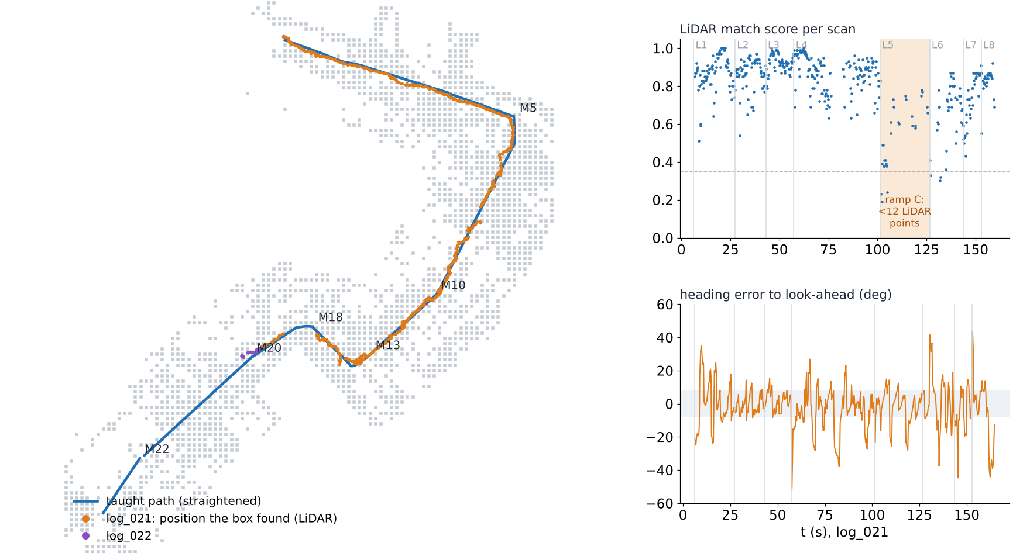
Fewer turns, no surges, located 94–97 %
LOG_020–022 · REPLAY AND RESULTS
per log | 015 | 020 | 021
switches/s | 1.74 | 0.90 | 0.85
turning | 30 % | 10 % | 9 %
at kick | 55 % | 0 % | 1 %
last leg | 4 | 10 | 8
located | – | 94 % | 97 %
Replay Arjun
Notes:
Replay: tools/replay_fw compiles the real route code (RouteFollow, LocalLocalizer, LocalPath.h) on the laptop and feeds a drive log through it, so we see what the box believed at every moment. The v3 logs also carry the box's own beliefs (position in the leg frame, heading error, match score, tap / kick / step flags). Left: every position the box found with the LiDAR in log_021 (orange) and log_022 (purple), drawn on the map; it stays on the straightened path from M1 through the ramp at M10–M13 to M20. Right: match score per scan and the heading error to the look-ahead point in log_021. On the ramp leg (L5, ramp C) 68 % of the scans have fewer than 12 usable LiDAR points, so the box carries on with gyro + distance there. Table: switches/s = changes between driving and turning per second; turning = share of time turning on the spot; at kick = share of forward driving at the 0.48 kick level (the jerks); last leg = furthest leg reached; located = share of time with a LiDAR position. log_015 is before the timed-tap controller and the MotorShaper changes; log_020 has the new controller with the old driven path; log_021 adds the straightened path (log_022 continues leg 8 → 9). Still open: the low board at the start of leg 4 was only seen by the right ultrasonic, which no stop rule uses; ramp mode switches the LiDAR stop off for the whole ramp leg, not only on the slope; in path mode walls that are in the map may come to 20 cm (log_020 leg 9 in front of building D). log_023 lost control because weak LiDAR matches turned the heading 30° away from the gyro; fixed since with the gyro heading prior.

Slide 7
Route segment : M7 to M12
OPEN SEA APPROACH
The M7– M12 section has no continuous walls, making LiDAR-based SLAM localisation less reliable. We use M7 and M12 from the SLAM map as reference points, with IMU heading control, LiDAR map corrections and ultrasonic obstacle detection to navigate through the OPEN SEA.
1. APPROACH
2. OPEN SEA RUN
3. ULTRASONIC · NEAR OBSTACLES
Compare the live rover position with the planned M7– M12 path using the Wi-Fi HMI.
Correct localisation using a 90-point LiDAR scan with coarse matching (±0.4 m / ±4°) and fine matching (2 cm / 1°).
Monitor lateral deviation and check position recovery near M12.
Ensure safety through ultrasonic and LiDAR obstacle detection, with tilt protection.
Runs the existing taught route until the rover reaches M7.
Use the estimated SLAM pose at M7 as the segment start reference.
Localisation updates every 0.25 s.
Continue from M7 towards M12 using the path follower, IMU heading feedback and LiDAR map corrections when scan features are available.
Open Sea Approach Manikant

Slide 8
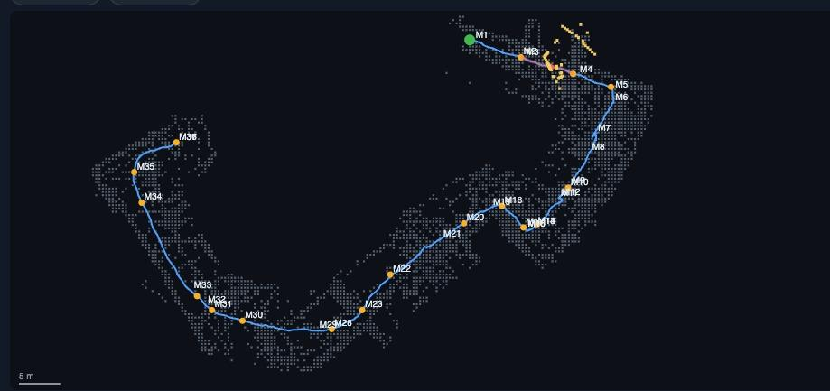
The rover deviated to the right of the planned path
FIELD TEST - RESULT
OBSERVED RESULT
The live rover track moved to the right of the planned M7– M12 path instead of staying on the intended line
TECHNICAL SIGNIFICANCE
The current heading / pose correction is not sufficient to hold the planned line in the low-feature Centre.
With few mapped walls, LiDAR scan matching provides fewer reliable corrections and heading prediction alone cannot constrain lateral drift.
Compared the planned M7 - M12 path with the rovers live estimated track. Main check; lateral deviation of drift through the low feature centre section and weather the mapped reference is recovered towards M12
Field Test Kethan

Slide 9
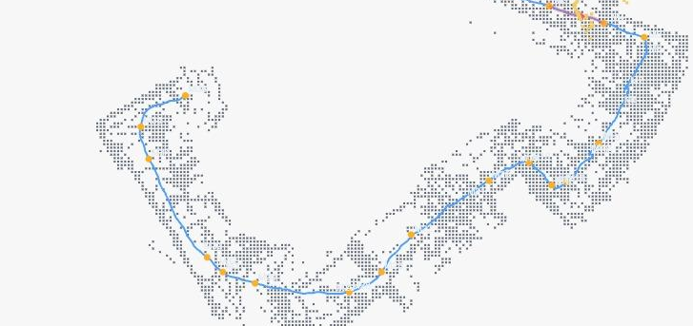
Results: M7 to M12
FIELD TEST - ANALYSIS
1. MAP MATCH AVAILABILITY
Check the LiDAR match score and usable scan points from M7 through the centre to M12. Identify where map correction becomes weak and where it returns.
2. HEADING CORRECTION
Compare gyro heading with the direction of travel. Verify the right-drift compensation, turn direction, tap duration and gyro-settle interval.
CONCLUSION
The existing teach-and-repeat system reaches the OPEN SEA entry, but the M7– M12 segment shows rightward path deviation. The next work is to use the localisation diagnostics and tune heading / path correction for the low-feature section, then repeat the same test and compare the track.
Field Test Vinay

